Slide 1
Coursera Capstone Project
Car Severity Accident
Alfredo Suarez

Slide 2
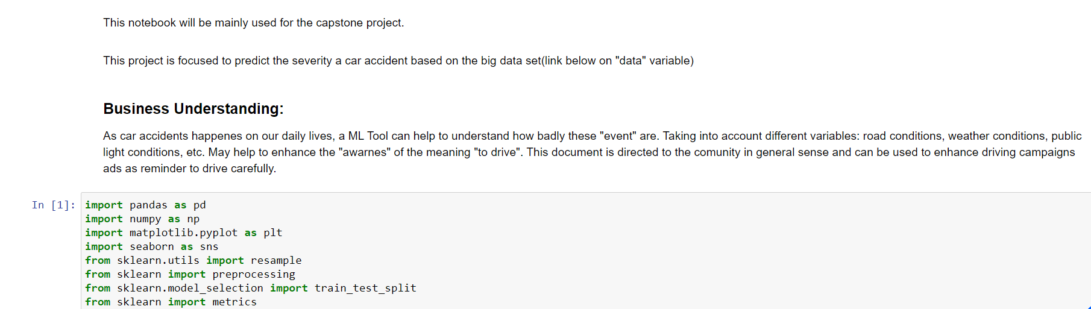

Slide 3
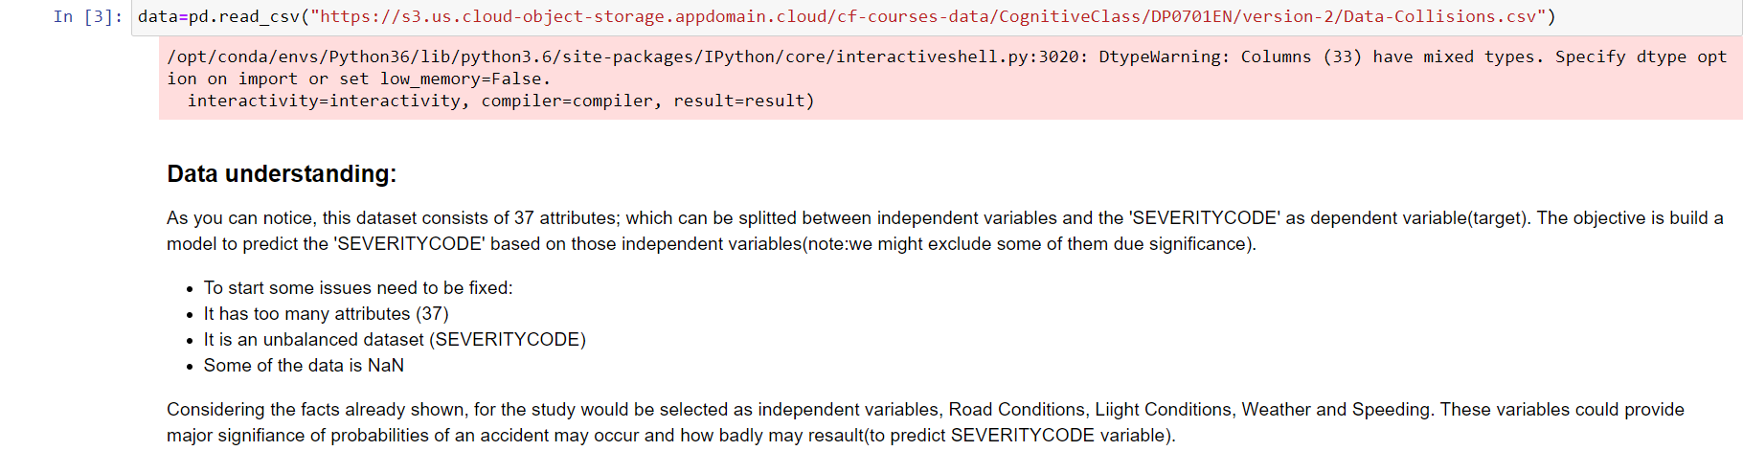

Slide 4
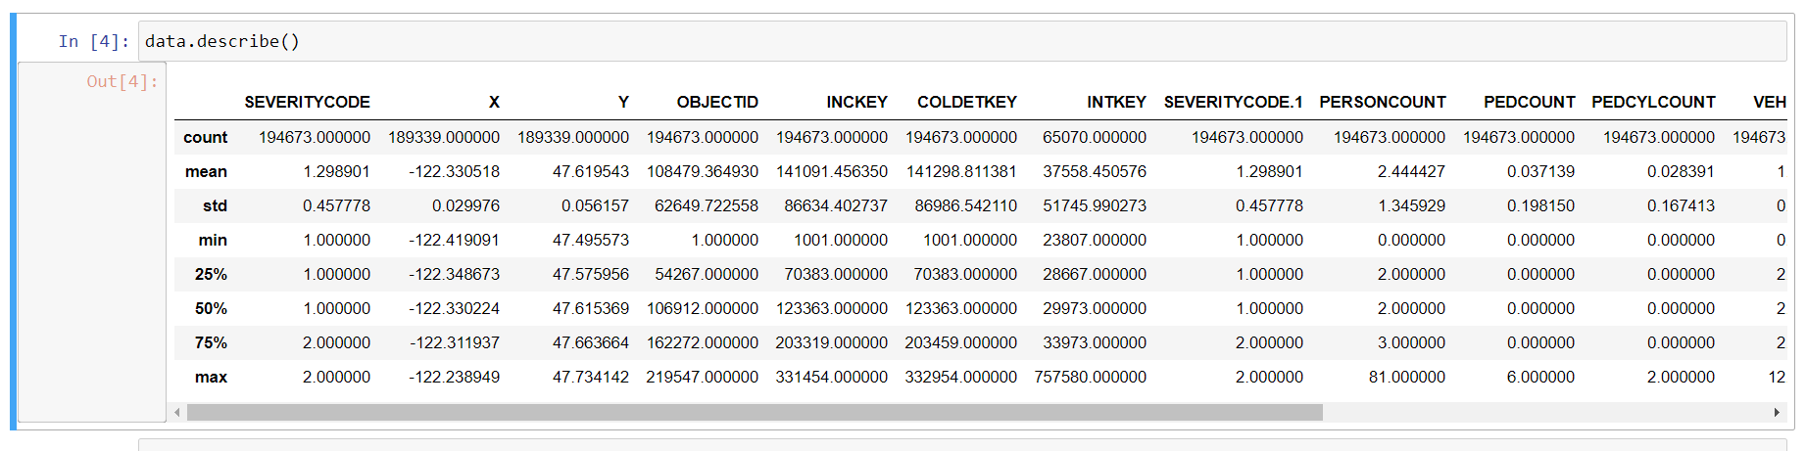

Slide 5
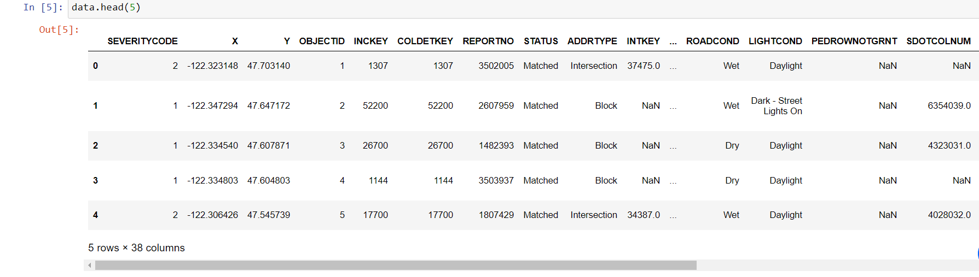

Slide 6
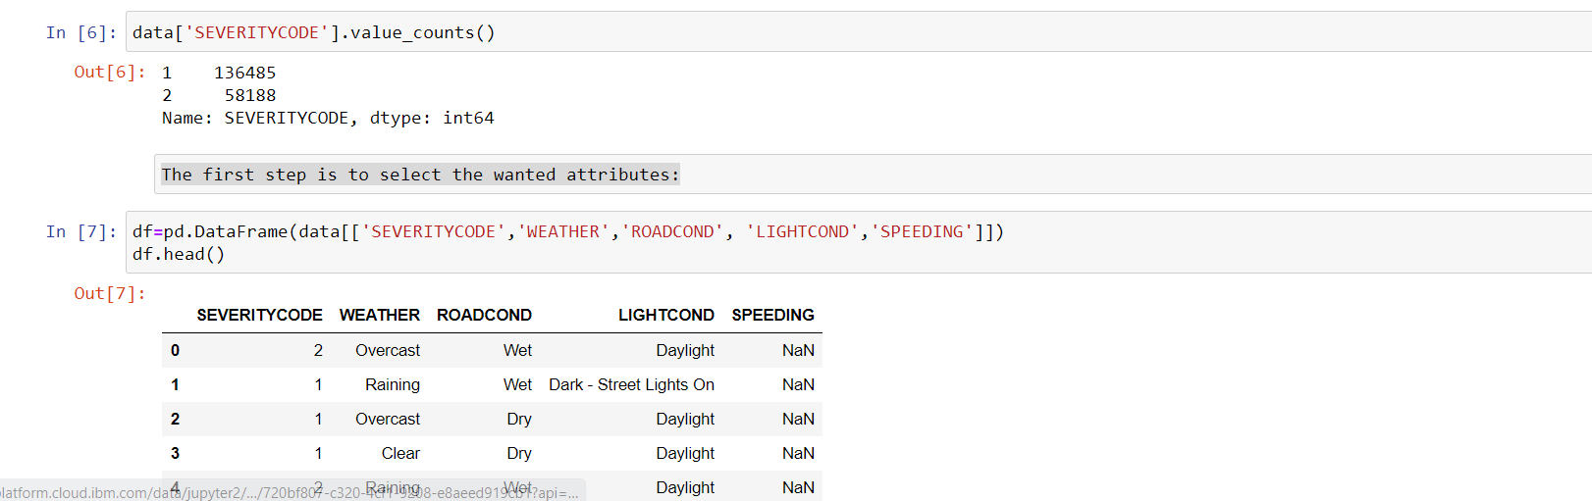

Slide 7
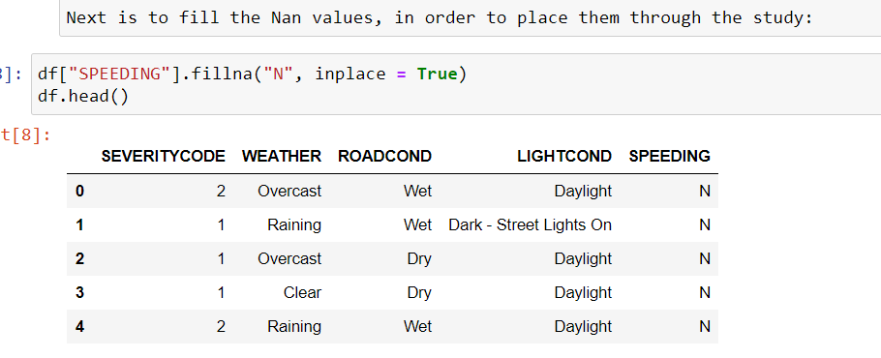

Slide 8
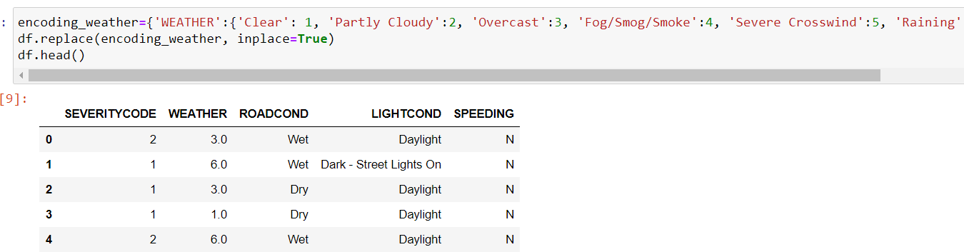

Slide 9
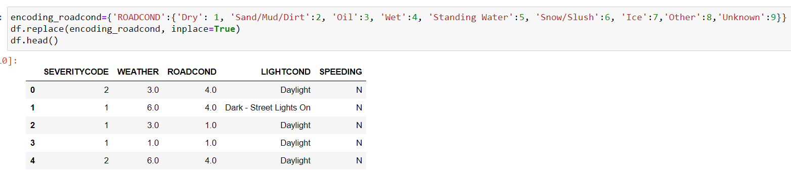

Slide 10
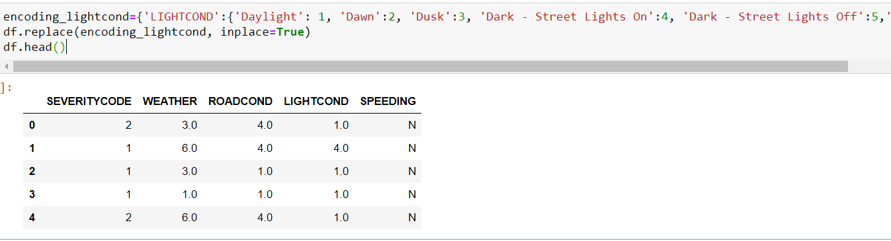

Slide 11
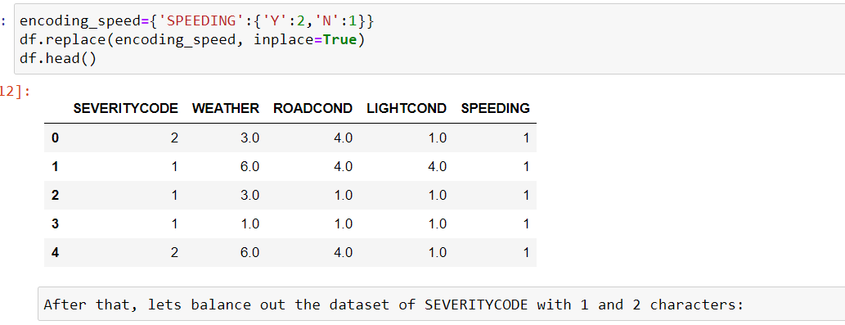

Slide 12
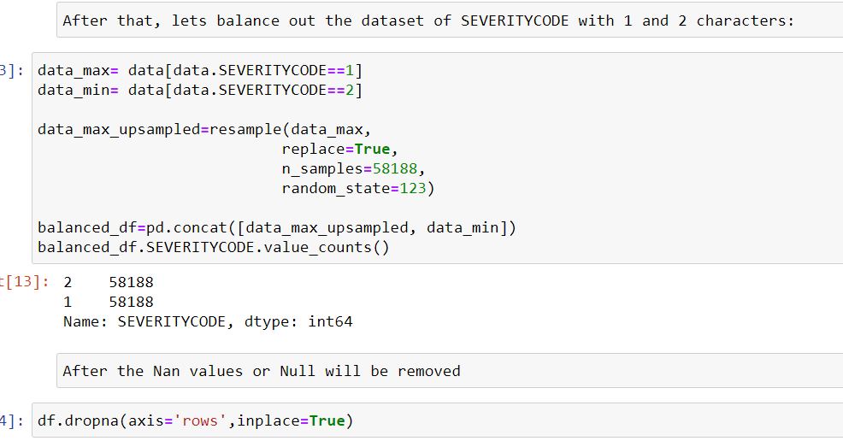

Slide 13
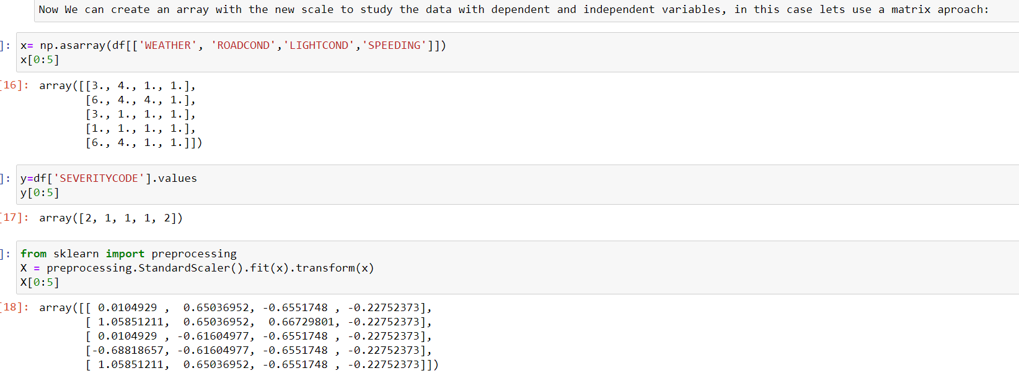

Slide 14
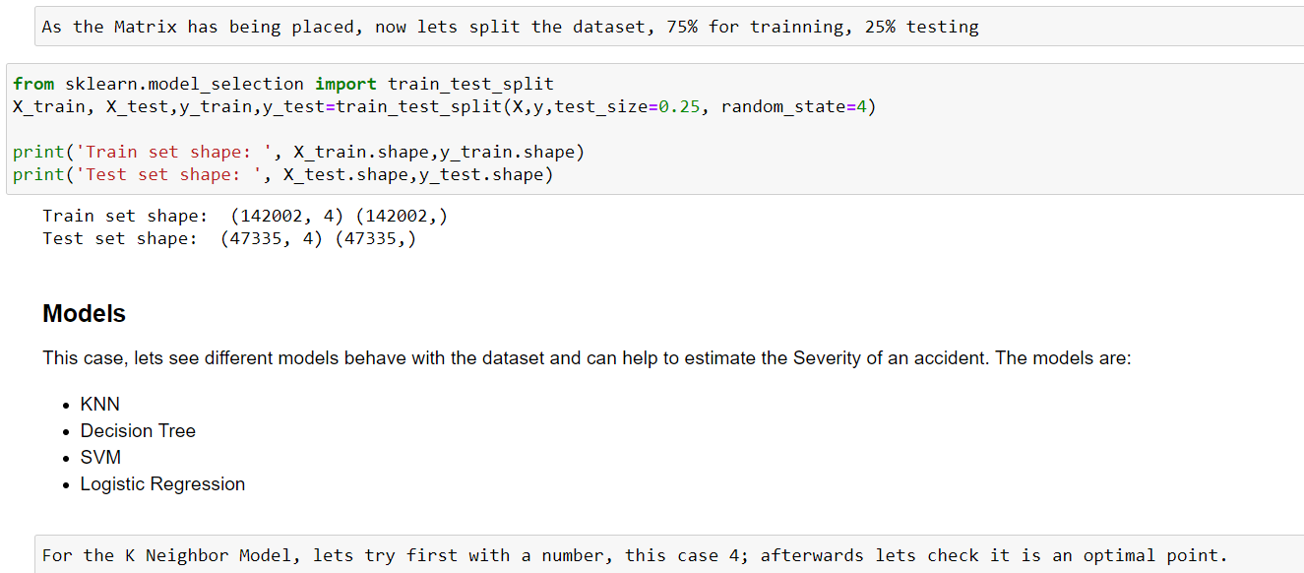

Slide 15
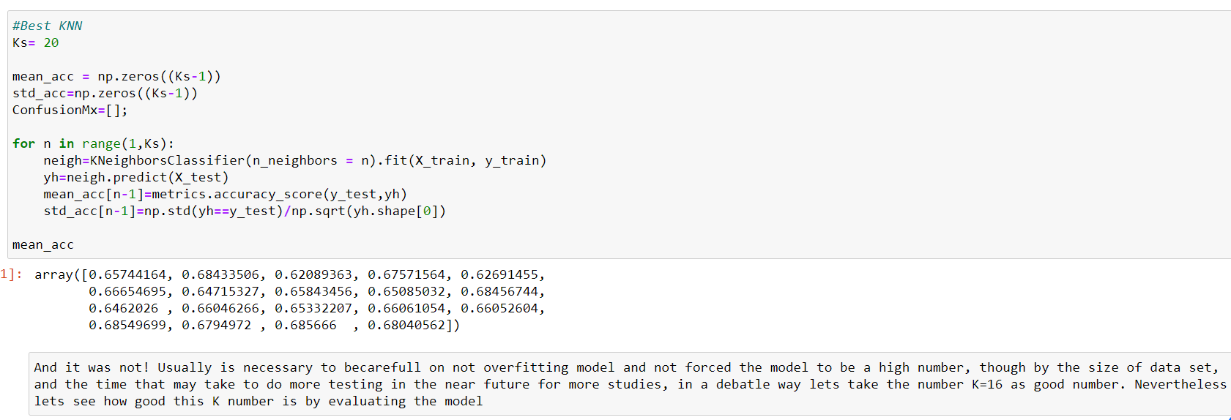

Slide 16
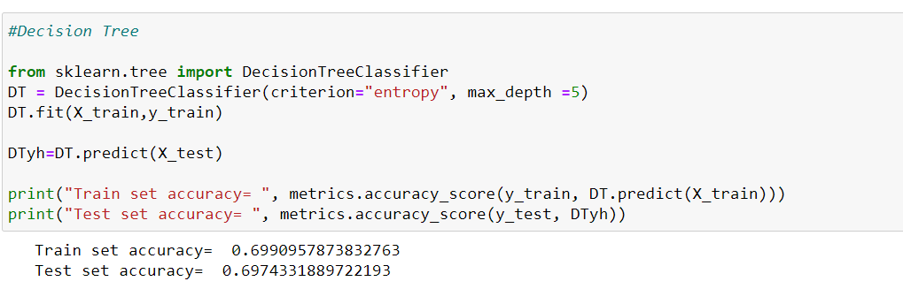

Slide 17
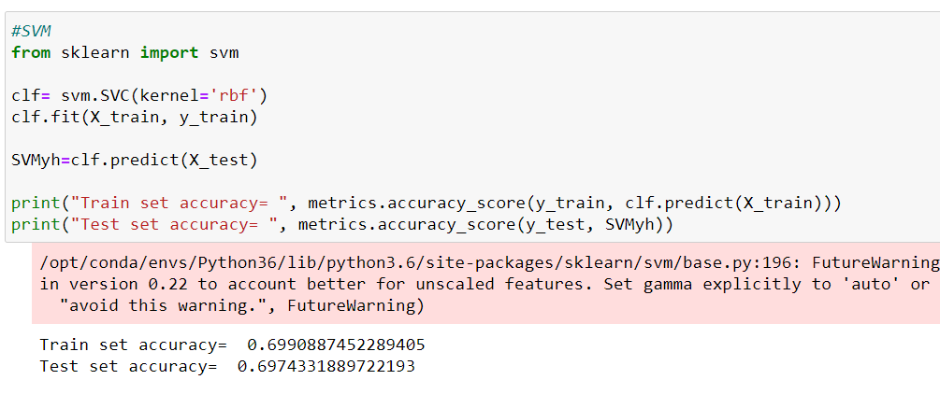

Slide 18
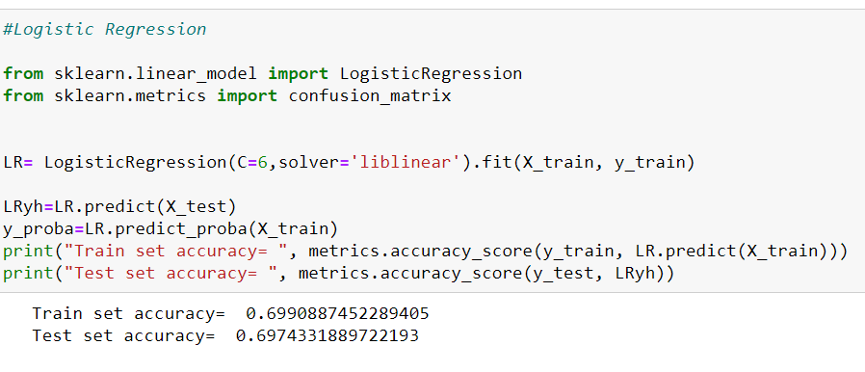

Slide 19
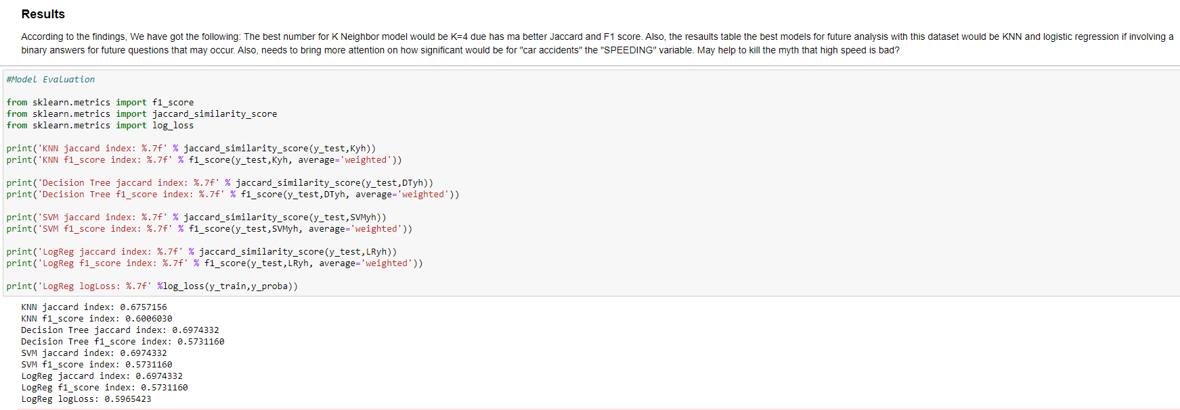

Slide 20
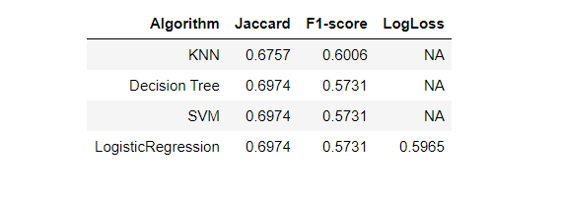
Conclusion
According to data, weather conditions have a certain impact as variable to conduct on accident, also if occurs will be more likely to result on property damage (class 1) or injury (class 2) and not fatal losses.
So, as data showed that most vehicle accidents occur during good conditions with somehow property damages what is left is to create campaigns to enhance “awareness” of driving and… DO NOT DRINK & DRIVE!

